Slide 1

Bank Data Analytics

Slide 2

Team Mates
Anurag Gundapi
Pranav Kumar Mehta
Rakesh Nayak
R Gayathri
Shantilal Navneeta
Sugandhini B S

Slide 3
Introduction
The banking sector generates vast amounts of data through loans and transactions.
This analysis aims to extract actionable insights to guide strategy and enhance operational efficiency.
Focus areas: Loan performance, customer demographics, transaction behavior, and risk monitoring.

Slide 4
Data Overview
Data extracted from "Bank Data Analytics.xlsx"
Covers: Loan disbursement, repayment, delinquency, customer profiles, and transaction logs
Time Range: [Insert exact dates from data file, e.g., Jan 2022 – Dec 2024]
Objective: Holistic view of lending and transaction patterns

Slide 5
Objectives - KPIs

Slide 6
Loan Metrics:
Total Loan Amount Funded
Total Loans (active + closed)
Total Collection and Interest Revenue
Disbursement Trend
Customer Segmentation:
Religion-Wise, Age Group-Wise, Grade-Wise, Product-Wise
State-Wise and Branch-Wise Distribution
Risk Indicators:
Delinquent Loans Rate, Default Rate, No Verified Loans
Count of Defaulted Loans and Delinquent Clients
Transaction Analytics:
Volume by Bank, Method Distribution, Branch Growth
High-Risk Transaction Flags and Suspicious Frequency

Slide 7
Process
Step 1: Data cleaning, transformation, and validation
Step 2: Calculation of KPIs using Excel formulas and pivot tables
Step 3: Segmentation by demographic and geographic attributes
Step 4: Risk pattern identification using threshold-based flags
Step 5: Dashboard preparation for visualization and insights
Tools Used: Excel, SQL, Tableau, Power BI

Slide 8
Analysis

Slide 9
Loan Trends:
Disbursements peaked in Q3 of the last fiscal year
Collection rate closely follows disbursement growth
Delinquency & Risk:
High delinquency observed in specific states and age groups
Risk of default correlates with low credit grades
Demographic Insights:
Spike in flagged transactions during festive seasons.
Majority loans issued to 25–40 age segment.
Certain branches underperform in recovery rate
Transaction Patterns:
Debit Card and Bank Transfer dominate methods
Branch transaction volume varies significantly; 3 branches showed negative growth

Slide 10
Bank Data Analytics Dashboards

Slide 11
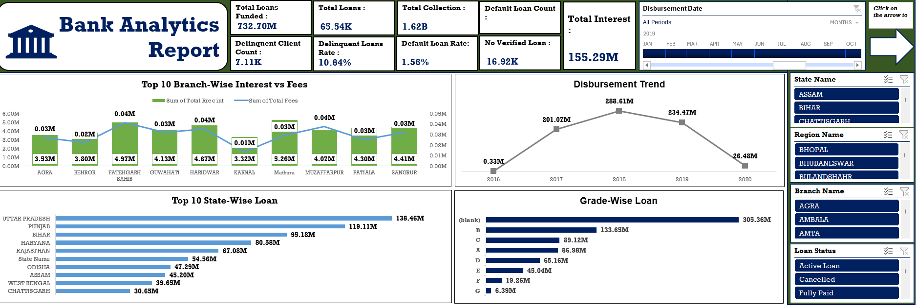
EXCEL DASHBOARD – REPORT 1

Slide 12
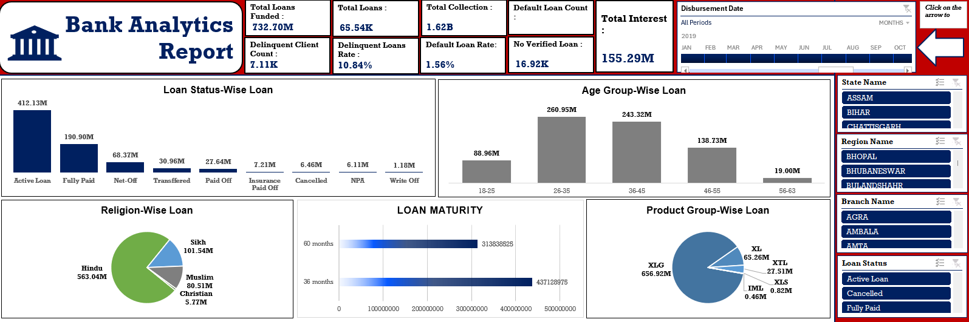
EXCEL DASHBOARD – REPORT 2

Slide 13
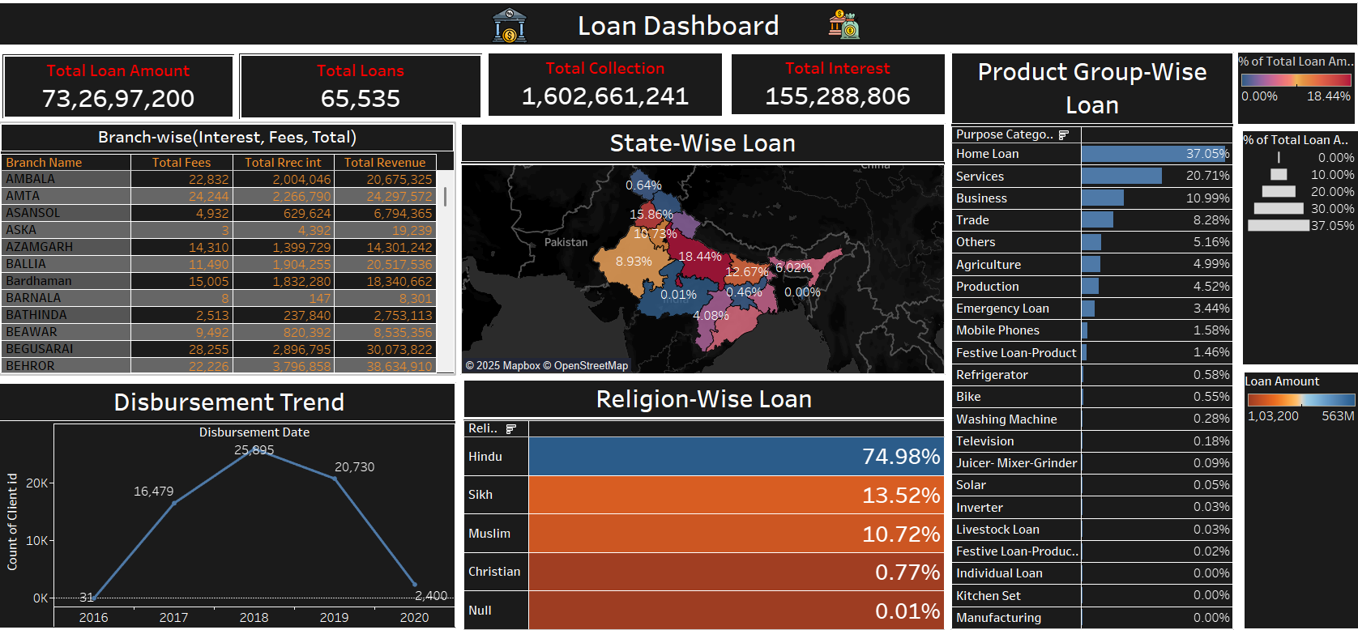
TABLEAU DASHBOARD – REPORT 1

Slide 14
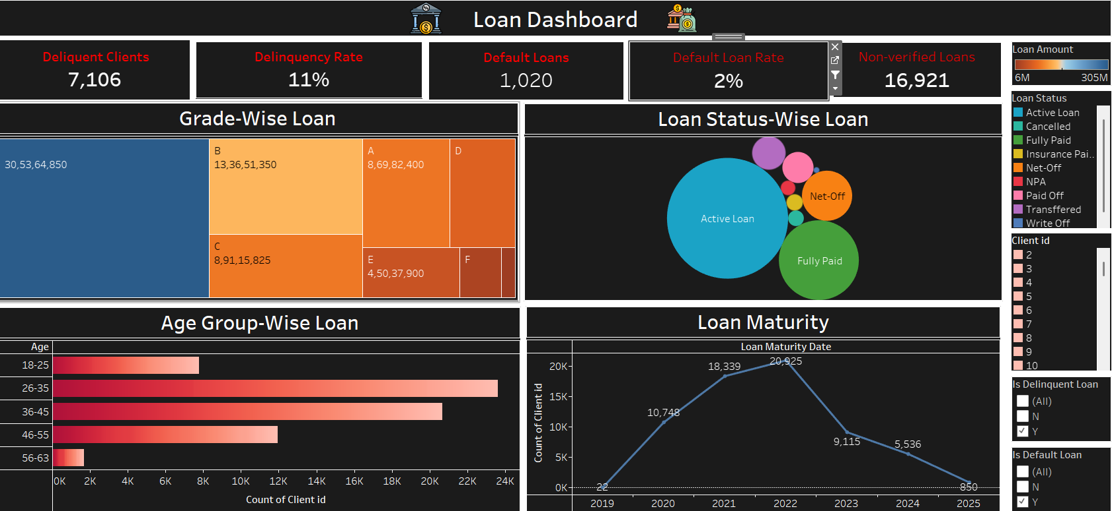
TABLEAU DASHBOARD – REPORT 2

Slide 15
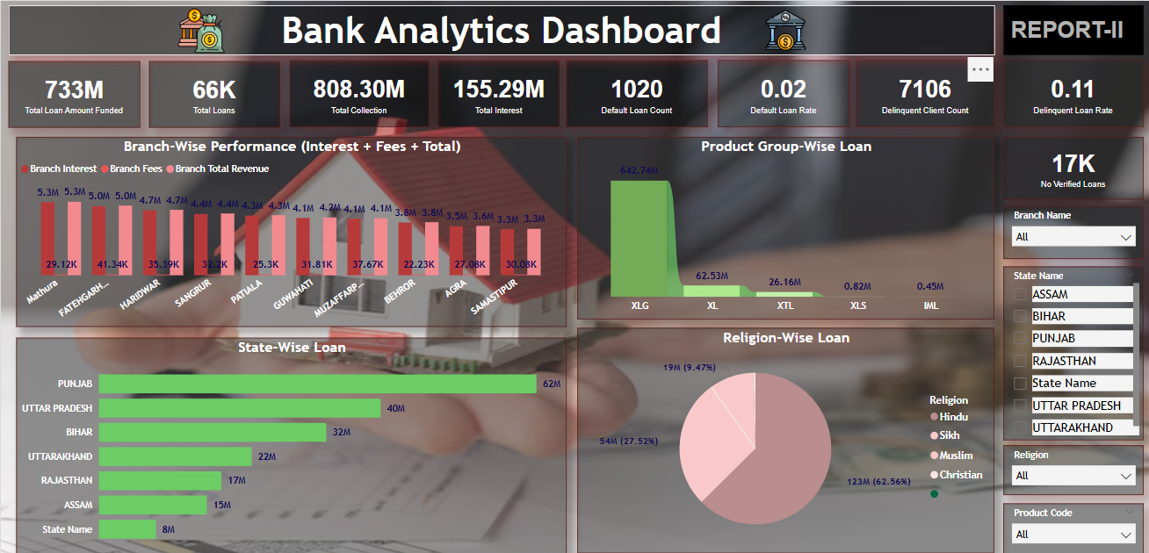
POWER BI DASHBOARD – REPORT 1

Slide 16
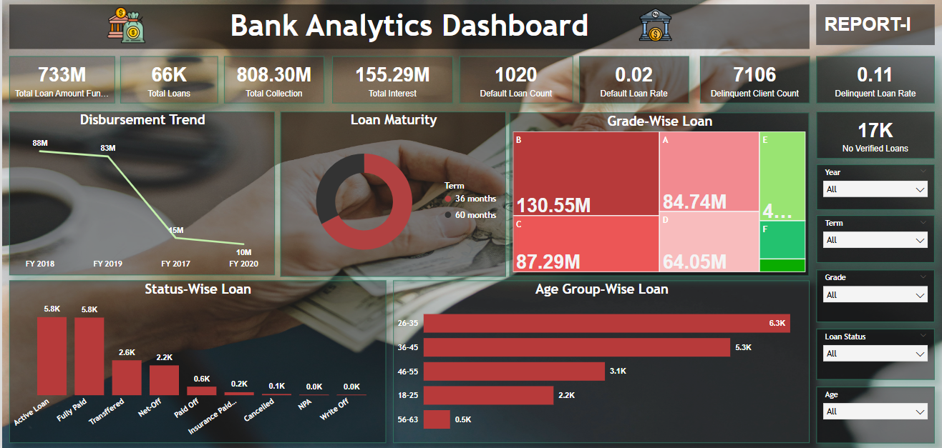
POWER BI DASHBOARD – REPORT 2

Slide 17
Recommendations and Insights
Collections: Enhance follow-up mechanisms in high-delinquency regions
Fraud Detection: Automate alerts for high-risk flags and anomalous spikes
Product Optimization: Invest more in high-performing loan products like personal loans
Compliance: Audit and address “No Verified Loans” to reduce risk exposure
Branch Strategy: Support low-growth branches with targeted outreach

Slide 18
Conclusion
Key takeaways: Patterns in disbursement, risk clusters, transaction behaviors
Insights support: Better fraud monitoring, collection strategies, and customer targeting
Next Steps:
Develop live dashboards for real-time monitoring
Initiate predictive modeling for default and fraud prevention
Train staff on data-informed decision-making

Slide 19
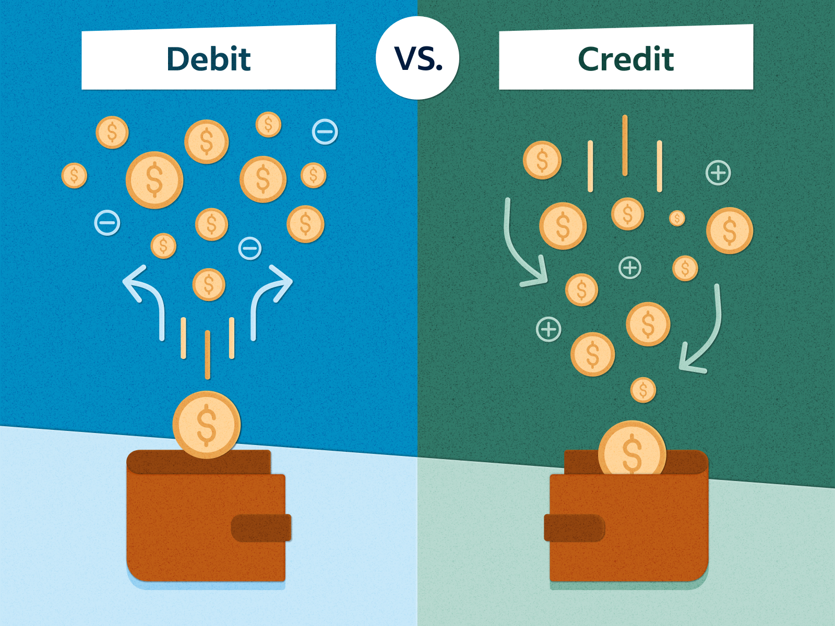
Bank Debit and Credit Analytics

Slide 20
Introduction
Overview of banking KPIs
Goal: uncover patterns and insights

Slide 21
Data Overview
Source: Transactional banking data (2024)
Fields: Customer, transaction, account, branch, bank
Currency: INR

Slide 22
Objectives: KPIs
1.Total Credit Amount
2. Total Debit Amount
3. Credit to Debit Ratio
4. Net Transaction Amount
5. Account Activity Ratio
6. Transactions per Day/Week/Month
7. Total Transaction Amount by Branch

Slide 23
Process
Data Cleaning and Preparation
Transaction Categorization
KPI Calculation
Trend Analysis
Segmentation and Visualization

Slide 24
Analysis
Higher credit volume observed in major branches
Net positive cash flow in 65% of accounts
Peak transaction periods: end of month and festival season

Slide 25
Debit and Credit Dashboards

Slide 26
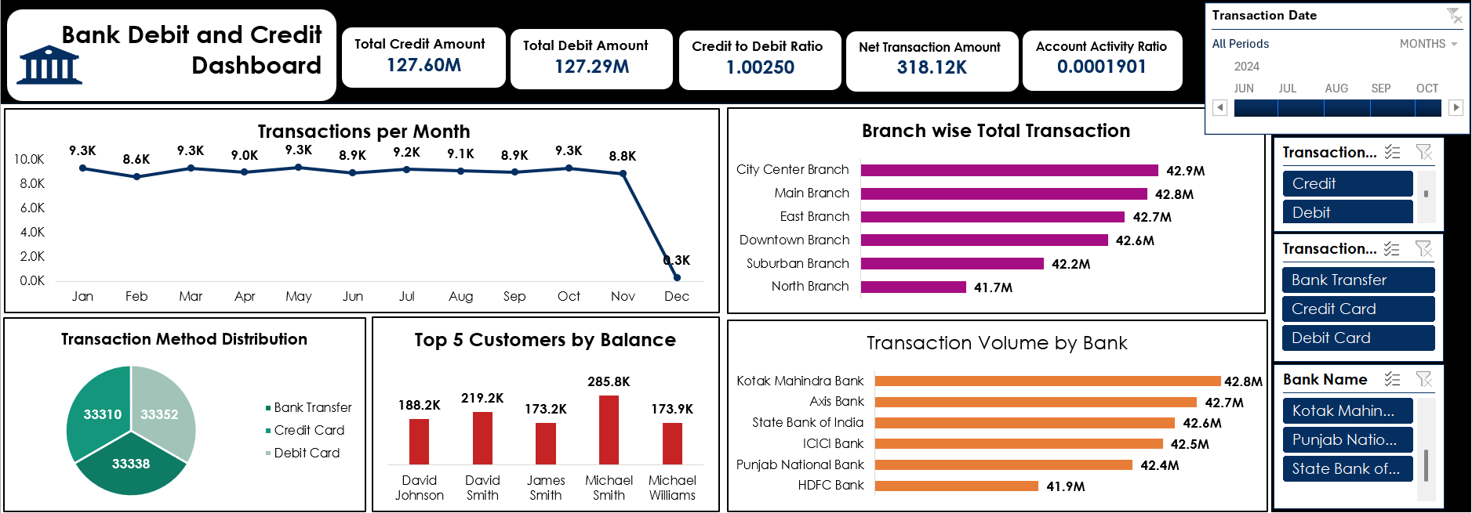
EXCEL DASHBOARD

Slide 27
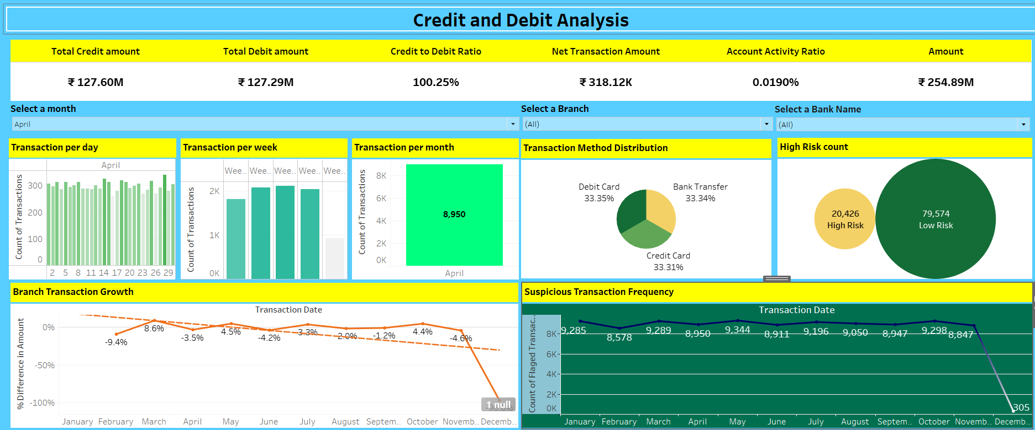
TABLEAU DASHBOARD

Slide 28
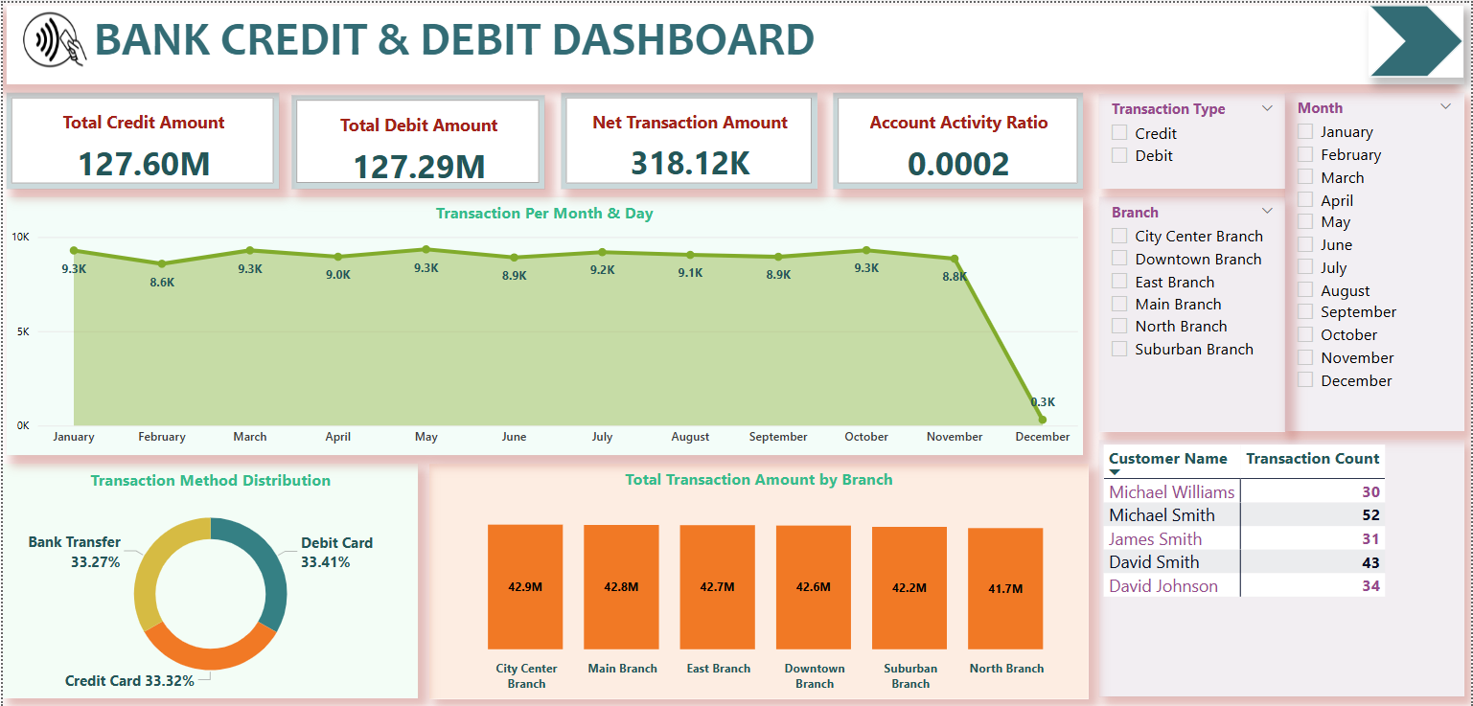
POWER BI DASHBOARD – REPORT 1

Slide 29
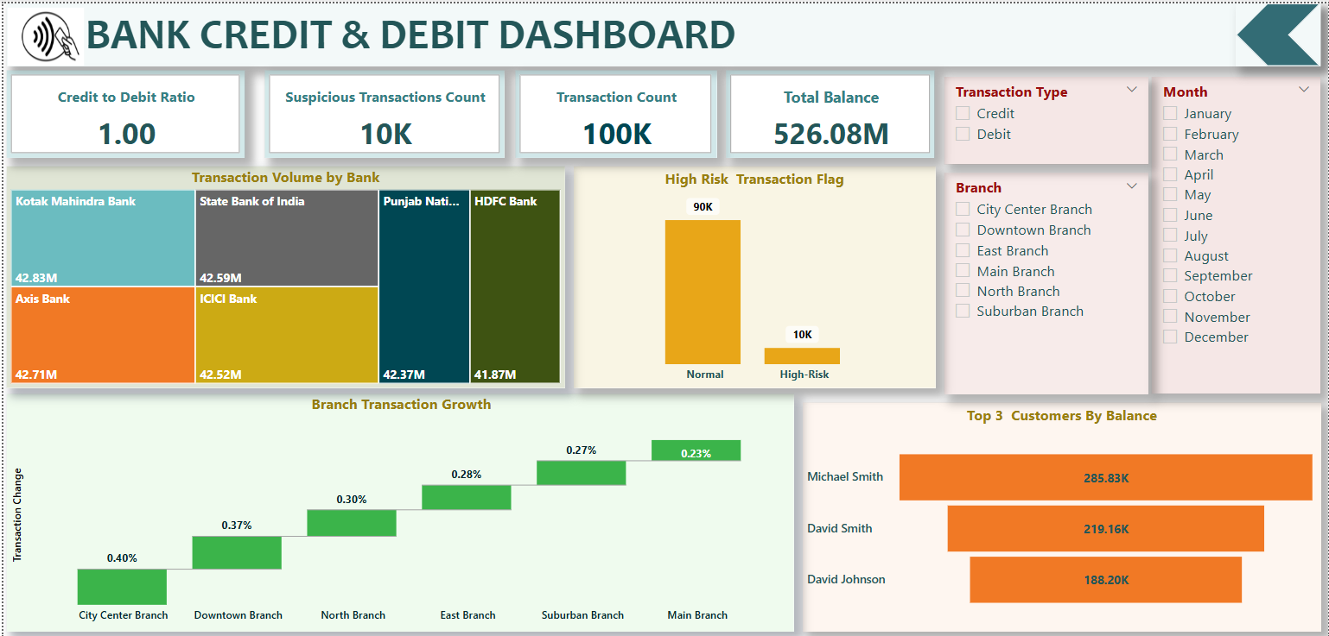
POWER BI DASHBOARD – REPORT 2

Slide 30
Recommendations and Insights
Optimize resources for high-performing branches
Target low activity customers for engagement campaigns
Forecast transaction spikes to improve service delivery

Slide 31
Conclusion
KPIs reflect healthy financial activity
Data-driven decisions improve banking performance
Next steps: Build real-time dashboard and monitor continuously

Slide 32
THANK YOU

